Slide 1
Code Sample and Github Link

Slide 2
GitHub Link
Here is the github link of the project
Front-end - https://github.com/StayMatch/staymatch-frontend
Back-end - https://github.com/StayMatch/staymatch-backend

Slide 3
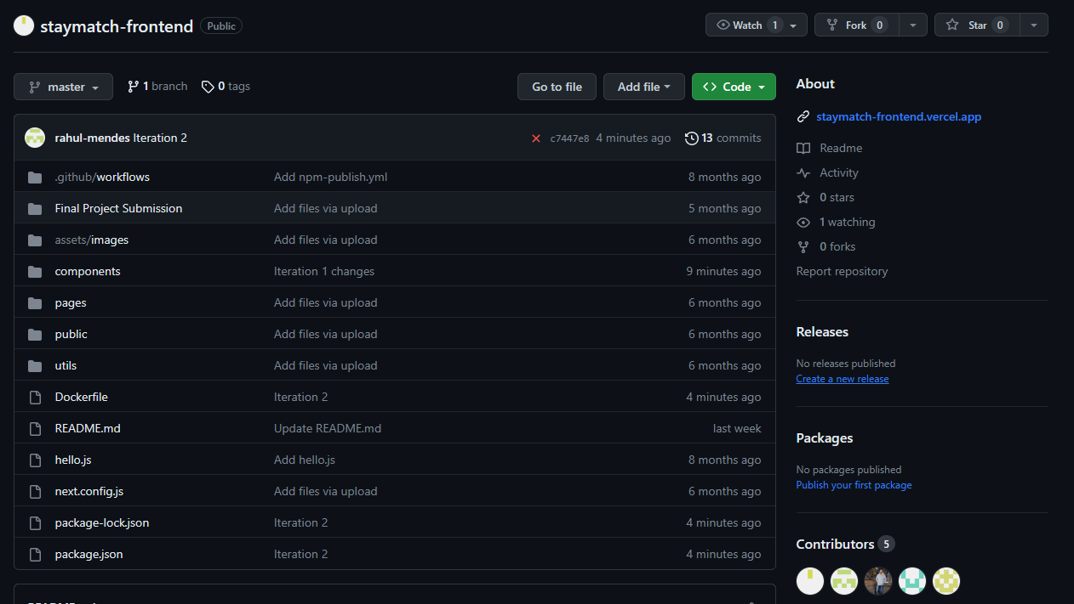
Staymatch front-end repository structure

Slide 4
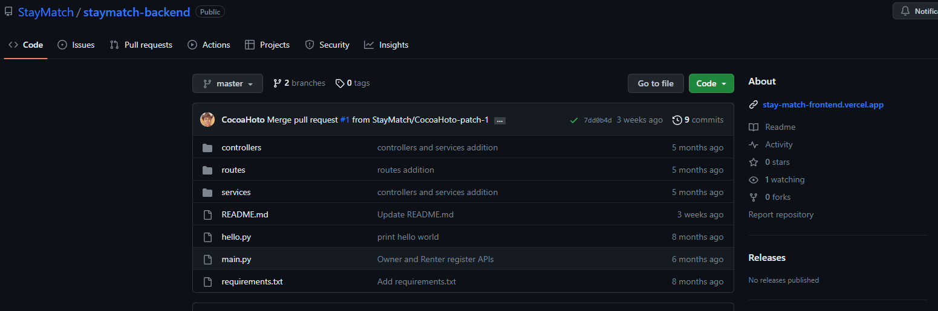
Staymatch back-end repository structure

Slide 5
Prerequisites and Installation
Node.js, React.js must be installed on your local machine.
Clone this repository to your local machine.
Open the folder in command line and run the following commands:
npm install
npm run dev

Slide 6
R1 – I1 Features
Sort
Search

Slide 7
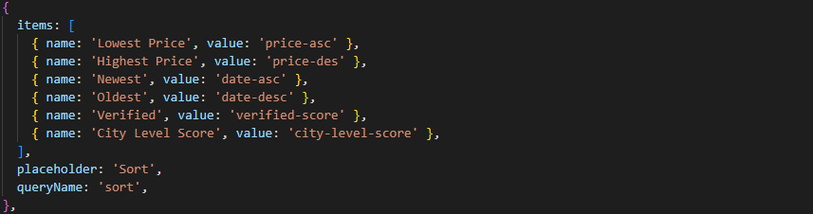
Feature: Sort by Price

Slide 8
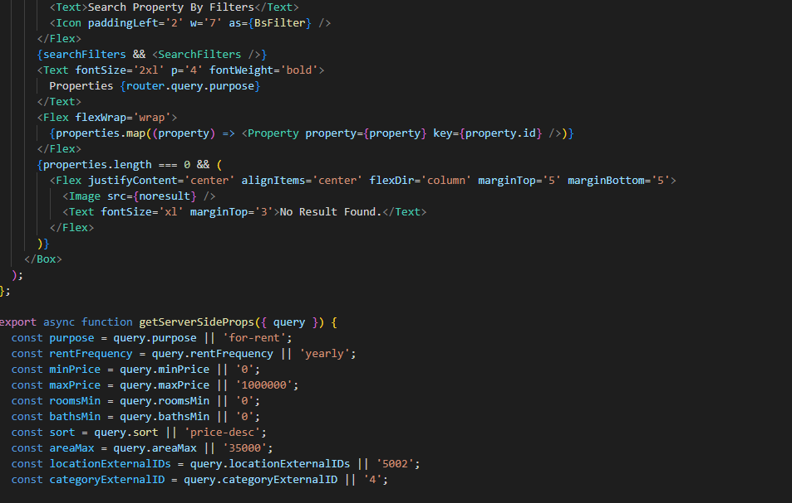
Feature: Search by zip

Slide 9
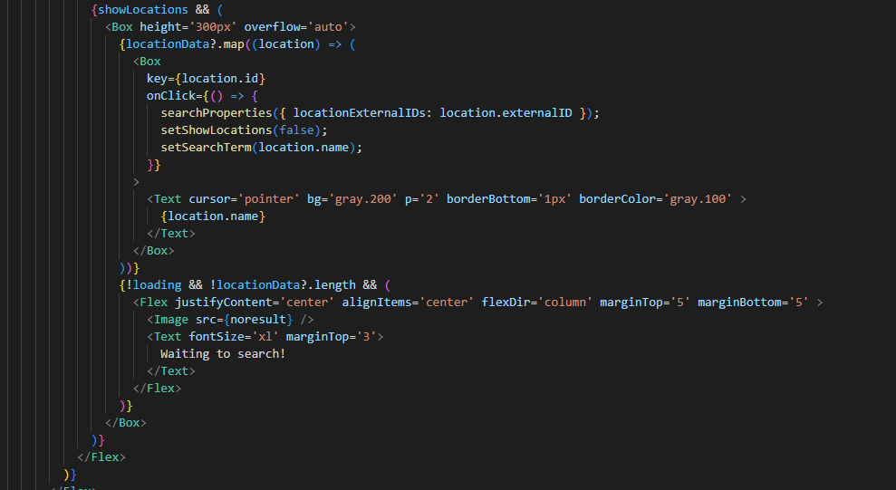
Feature: Search by city

Slide 10
R1 – I2 Features
Show Property Details
Show Property Amenities

Slide 11
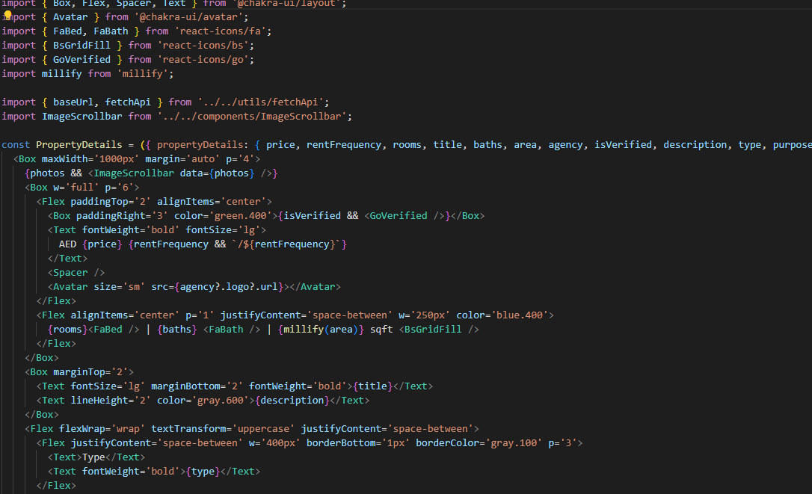
Feature: Show Property Details

Slide 12
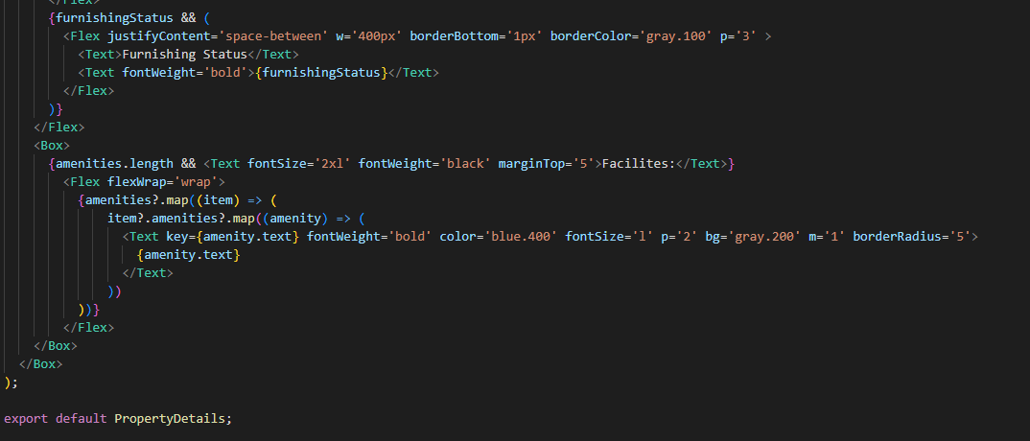
Feature: Show Property Amenities

